Slide 1
Developing Integration Solutions using Microsoft BizTalk Server 2016
Testing and Deploying Projects

Slide 2

Course Outline
Module 1: Introduction to BizTalk Server
Module 2: Schemas
Module 3: Maps
Module 4: Testing and Deploying Projects
Lesson 1: Unit Testing
Lesson 2: Deploying BizTalk Projects
Module 5: Pipelines
Module 6: Routing
Module 7: Adapters
Module 8: Web Services and WCF
Module 9: Introduction to Orchestrations
Module 10: Applied Orchestration Techniques
Module 11: Business Activity Monitoring
Module 12: Integrating Business Rules
Module 13: Deploying and Managing Applications
Module 14: Windows Azure BizTalk Services

Slide 3
Lesson 1: unit testing
Introduction to Unit Testing

Slide 4

What is Unit Testing?
Unit testing is a method by which individual units of source code are tested to determine if they are fit for use.
One can view a unit as the smallest testable part of an application.

Slide 5
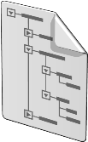
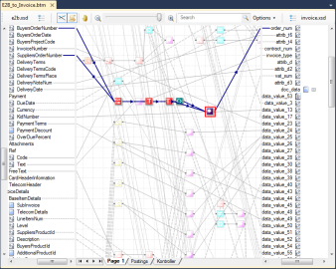

Unit Testing BizTalk Artifacts
Schemas
Maps
Pipelines

Slide 6
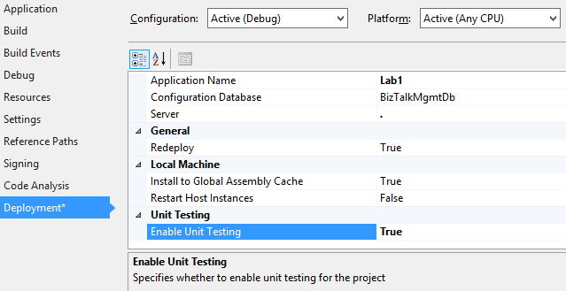
Preparing projects for unit tests
Creating Unit Tests
Must be enabled on project level to be used.
Requires Visual Studio Test features, or some other test application like NUnit/BizUnit.

Slide 7
Steps to Create Unit Tests for Schemas, Maps and Pipelines
1
2
3
Set Enable Unit Testing to true on BizTalk project
Add a Test project to solution
Select the artifacts to test
4
Add reference to Microsoft.BizTalk.TestTools
5
Add reference to Microsoft XLANG/s Base Types
6
Collect test input (and optionally output) data
7
Add code to execute test
7
Run test and verify outcome

Slide 8
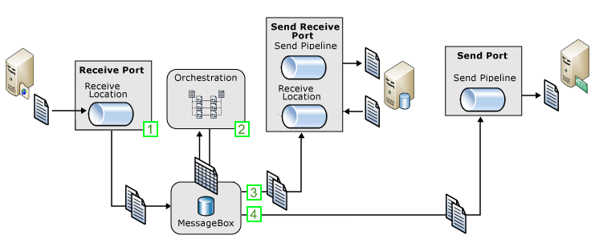
Performing Scenario / System / Integration tests
Nunit
Visual Studio Test
BizUnit
Mocking

Slide 9

Demo
Adding a Test project
Building a test to unit test a schema
Notes:
(Slide 6)
Open solution c:\Demos\Mod4\Start\Mod4Demo1.sln
On project properties, Deployment - Enable Unit Testing.
Build the Mod4Demo1 project.
Add new project to solution, under test template choose Unit Test project
Add reference to Mod4Demo1, Microsoft.BizTalk.TestTools.dll and Microsoft.XLANGs.BaseTypes.dll
Add:
using System.IO;
using Mod4Demo1;
using Microsoft.BizTalk.TestTools.Schema;
Add follwing in under testmethod1:
Customers target = new Customers();
string schemaInstance = @"C:\Demos\Mod4\Customers.xml";
Assert.IsTrue(File.Exists(schemaInstance));
Assert.IsTrue(target.ValidateInstance(schemaInstance, OutputInstanceType.XML));
Run Test.

Slide 10


Hands-On-Labs
Unit Test and Deployment
Enable Unit Testing for BizTalk projects
Create Unit Tests
Exercise 1-4

Slide 11
Lesson 2: deploying biztalk projects
Deploying a project
Grouping artifacts into projects
Versioning projects
Viewing installed assemblies

Slide 12
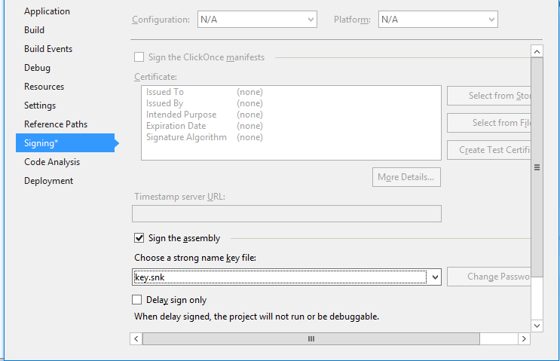
Strong names
Strong named assemblies
Are signed with a digital signature key.
Can call only other strong named assemblies.
Ensure unique and reliable identification of assemblies.
Are required by the GAC and BizTalk Server.

Slide 13


Tools for deploying an assembly
Visual Studio
Used by developer on development machine.
Use the Deploy command.
BizTalk Administration Console
GUI Administration tool used in production.
Use the Add Resource command.
BTSTask
Command line tool used from scripts etc.
Use the -AddResource flag.

Slide 14
Deploy a project from Visual Studio
1
2
3
Configure the project with a key file
Set deployment properties
Build and Deploy the project
4
Start the application
5
Test the application

Slide 15
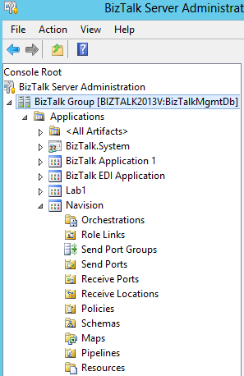
What is a BizTalk Application?
A BizTalk Application is a logical container for BizTalk Artifacts and Messaging Components (and other resources).
BizTalk Artifacts
Schemas
Maps
Pipelines
Orchestrations
Messaging Components
Receive ports
Receive locations
Send ports
Send port groups
Other
Policies
Role Links
Resources (BAM definitions, binding files, assemblies, scripts etc.)

Slide 16
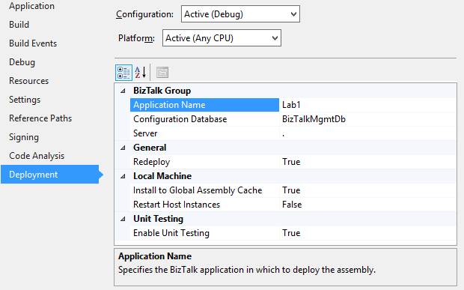
Configuring what Application a Visual Studio project belong to
Deployment configuration:
Application Name
SQL Server database
Server name. Using a . means the local machine.
Re-deploy
GAC
Restart
Enable Unit Testing

Slide 17
Demo
Deploying from Visual Studio
Assign a strong name to a project
Set project deployment properties
Deploy
Notes:
(Slide 13)
Continue on solution c:\Demos\Mod4\Start\Mod4Demo1.sln
Go to Project Properties, Signing.
Add a new Strong Name Key. Call it Key. Do not use password.
Build the project.
Right click the project and select Deploy

Slide 18

Reuse, or not reuse. That is the question…

Slide 19
Using shared assemblies
Benefits:
Cross application content routing
Using canonical types
Not duplicating work
Challenges
Deployment

Slide 20
Cross application content routing
Application 1
Application 2
Assemby
Schema
Property schema
DiscountCode == 10001
Receive Port
Send Port
Cross application content routing requires Application reference

Slide 21
Cross application content routing
Application 1
Application 2
Assemby
Schema
Property schema
DiscountCode == 10001
Receive Port
Send Port
Application 1
Application 2
Assemby
Schema
Property schema
CustomerType == ”VIP”
Send Port
Receive Port
Notes:
Point out that this is not possible due to the restrictions on circular references of Applications

Slide 22
Cross application content routing
Application 1
Application 2
Assemby
Schema
DiscountCode == 10001
Receive Port
Send Port
Application
reference
”Shared” Application
Application
reference
Assembly
reference
Assemby
Property schema
Notes:
Point out that this is not possible due to the restrictions on circular references of Applications

Slide 23
Using shared types
Application 1
Application 2
Assemby
Assemby
Order1 Schema
Order2 Schema
Order1_to_Order2 Map
Execute Order1_to_Order2 Map
Receive Port
Send Port
Application 3
Assemby
Updating Order1 schema require removing all referenced assemblies
Order3 Schema
Order1_to_Order3 Map
Execute Order1_to_Order3 Map
Send Port

Slide 24
Using canonical types
Application 1
Application 2
Assemby
Assemby
Order1 Schema
Order2 Schema
Order1_to_SharedOrder
SharedOrder_to_Order2
Execute Order1_to_Order2 Map
Receive Port
Send Port
Shared Application
Application 3
Assemby
Assemby
SharedOrder Schema
Order3 Schema
SharedOrder_to_Order3
Execute Order1_to_Order3 Map
Send Port
Notes:
Point out that all applications needs to reference to Shared Application if routing on MessageType

Slide 25


Composing loosly coupled applications
Orchestation.Order
Orchestrations
Canonical.Schemas.Order
Schemas
SAP.Transformations.Order
SAP.Transformations.Order
SapOrder_to_OurOrder
OurOrder_to_NavisionOrder
SAP.Schemas.Order
NavisionSchemas.Order
Schemas
Schemas

Slide 26
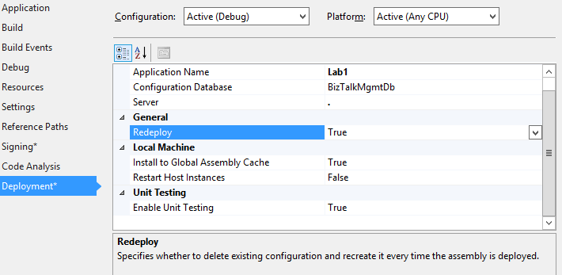
Versioning a BizTalk project
How to version
Implication on deployment
Use AssemblyVersion to version assemblies.
Only use Major and Minor version numbers.
Deploying a version that already exists may fail.
Binding files may need to be updated.
Re-deploying an existing assembly may require a host instance restart.

Slide 27


Version strategies
Single version or Increment version (SxS)
All artifacts are versioned through AssemblyVersion
Schemas are resolved using MessageType
Hint!
Updating assemblies that use static versioning
may require a host instance restart!
Caution!
Remember to update binding files when you update the version in the project.

Slide 28


Version strategies
Single Version
Easy Control
Easy deployment
Easy code versioning
Complex substitution
Require downtime
Multi Version
No downtime
Parallell active versions
Branches
Require cleanup
Require disipline

Slide 29
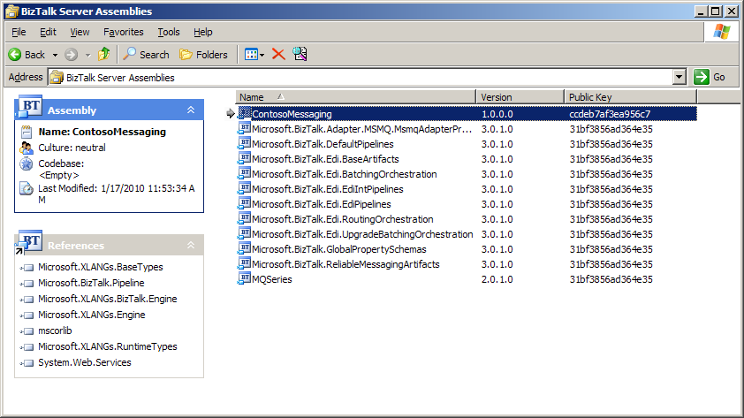
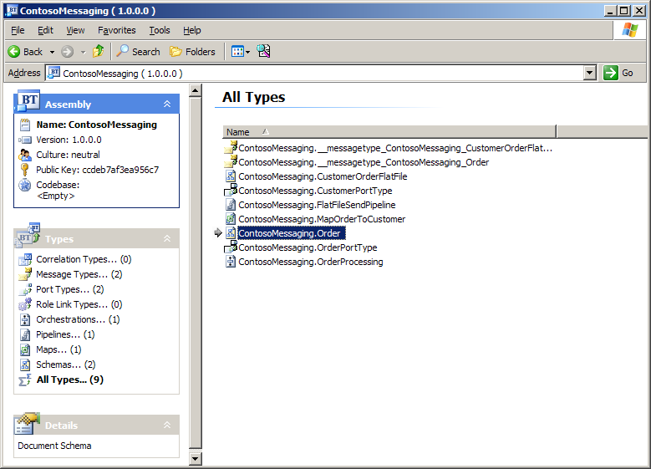
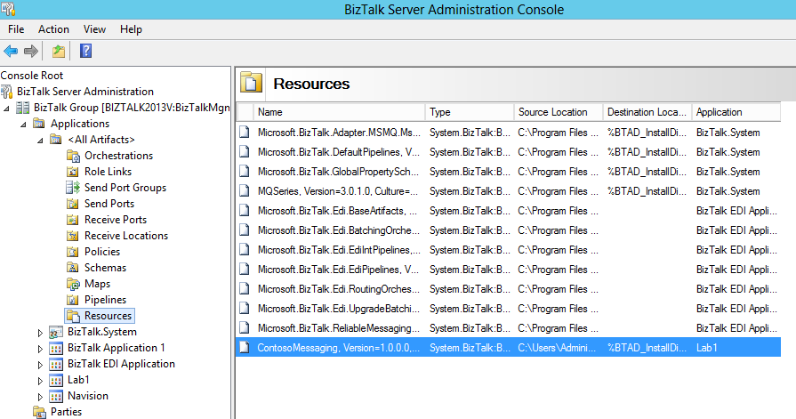
Viewing deployed assemblies
BizTalk Assembly Viewer
BizTalk Administration Console

Slide 30
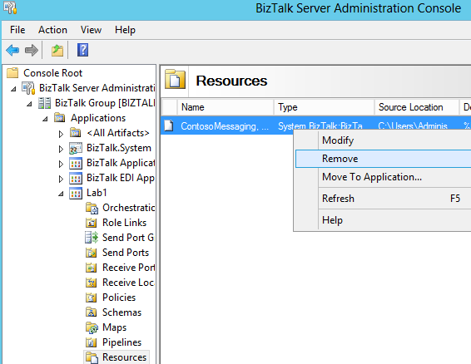
Undeploying an assembly
Remove resource
Tips!
You can also use BTSTask to remove resource.
Info!
Removing a resource does not remove the assembly from the GAC.

Slide 31
Demo
Viewing installed asemblies
View installed assemblies
Undeploy an assembly
Notes:
(Slide 19)
Open BizTalk Server Admininstration Console
Expand BizTalk Group
Expand Applications
Expand BizTalk Application 1
Go to Resources
Also show the All Artifacts view

Slide 32
Summary
BizTalk Server artifacts can be both manually and automatically unit tested to allow for early error detection and regression testing.
BizTalk Server artifacts are grouped into projects and must then be deployed to the BizTalk Group (database) as well as into the GAC to be available to the runtime.
Projects are versioned using .NET AssemblyVersion and managed using the BizTalk Administration Console.

Slide 33
Q & A
Testing and Deploying Projects

Slide 34
Hands-On-Labs
Unit Test and Deployment
Deploy BizTalk projects
Use the BizTalk Administration Console to verify deployment.
Exercise 5-6

Slide 35

Quiz
What are the benefits of using BizTalks Unit Testing API’s?
What are some of the pros and cons of different versioning strategies?

